Slide 1

ONLINE QUIZ SYSTEM
-TAKSH BOHRA(18BIT0296)
-YATHARTH GOURI(18BIT0315)
-HARSHIT KHERA(18BIT0371)
-KRITIKA GARG(18BIT0427)

Slide 2
PROBLEM STATEMENT
As currently whole world is suffering from COVID-19 outbreak so we decided to built an application that will help teachers as well as students during these times. QUIZ SYSTEM is a software developed especially taking the pandemic situation into consideration as most of the educational institutions are conducting online classes so this application help teachers in easy evaluation and also monitor each students progress. Teachers can assign the quiz to students after every class to know if the students are able to understand or not in the virtual classes. Quiz System is accessed by entering the username and e-mail id which is added to the database. Before start of the Quiz, the rules and regulations are displayed that includes description of time limit, number of questions to be answered and scoring methods. If the answer is correct, score is incremented and no negative marks for wrong answers. Final score will be displayed and updated in the database with username.

Slide 3
ABSTRACT
The ONLINE QUIZ AND CONTEST MANAGEMENT SYSTEM is a web application to take online quiz in an efficient manner with no wasting of time for checking the paper.
Teachers give papers to students according to their convenience and time and there is no need of using extra things like paper, pen etc. This can be used in educational institutions as well as in corporate world. There is no restriction that examiner has to be present when the candidate takes the test. This Web Application provides facility to conduct online examination worldwide. It is automatically generated by the server. Administrator has a privilege to create, modify and delete account for teachers.
The main objective of ONLINE QUIZ AND CONTEST MANAGEMENT SYSTEM is to efficiently evaluate the candidate thoroughly through a fully automated system that not only saves lot of time but also gives fast results.
It saves time as it allows number of students to give the exam at a time and displays the results as the test gets over, so no need to wait for the result.

Slide 4
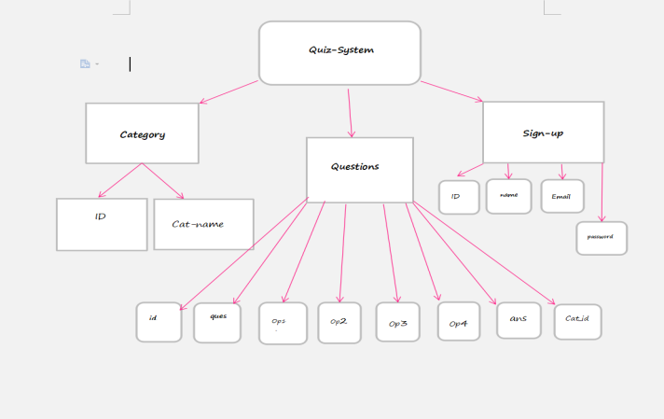
PROCESS FLOW DIAGRAM

Slide 5
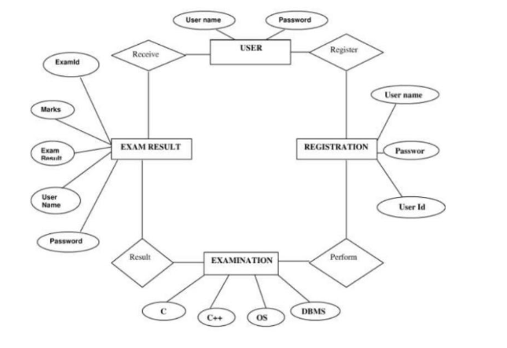
ER DIAGRAM

